Slide 1

The Complete RFID Solution
Total Warehouse Inventory Control

Slide 2



Our Mission
Strive for leadership in customized, reliable, and cost effective total RFID solutions.
Offer flexibility, customization, and innovation, enabling our customers to better protect and manage their facilities, inventory, and personnel.
Provide customers with added value, quality products, and long-term promise of RFID advanced technology.

Slide 3
Profile
Founded in 2001 by Touraj Ghaffari with years of experience and resources in RFID hardware and system integration.
Our corporate office is located in Boca Raton, Florida and employs over 140 man years in product development.
ActiveWave products are designed and manufactured in the United States of America. Compliant with US and Euro standards. Patent Protected intellectual property.

Slide 4
Benefits of our system
Provides total asset visibility
Gives full inventory history
Allows reduced stock levels
Facilitates "Just-in-Time" deliveries
Provides full process control for products in the facility
Reduces lead-time
Provides higher-level security
Reduces errors
Reduces overall cost of operations
Shortens cross docking time
Speeds up sort/pick rate
Reduces required shelf space

Slide 5
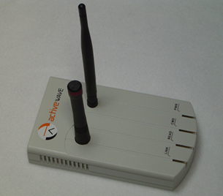
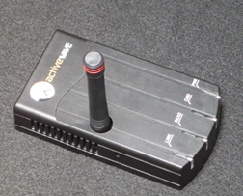
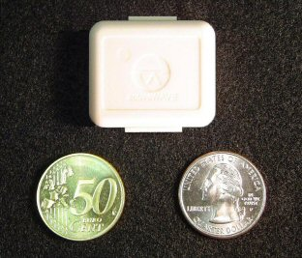
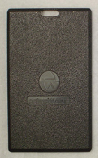
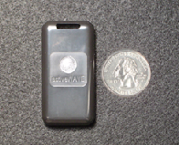
Active Components
Reader
Has built in Field Generator
Listens for Tag beacons, can identify individual tags
Programs tags with ID and how to behave
Full Duplex – broadcasts at 433 MHz and listens
on 916 MHz, 927 MHz, or 868 MHz
Field Generator
Sends out signal and wakes up active tags
Transmit range configurable to match zone
Continuous or sensor based
Tags
Various types to match application
Available with options including LED and Buzzer
Can track temperature and tamper history

Slide 6
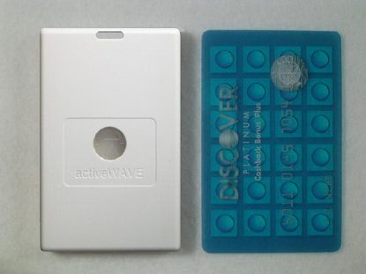
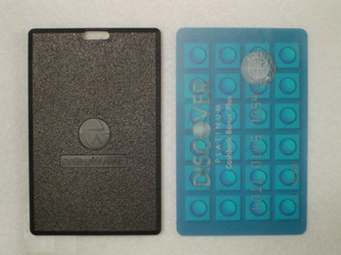
ActiveWave Tags
miniTag
100’ transmit range
Small parts
compactTag
145’ transmit range
Medium-size bins, boxes, etc.
cardTag
280’ transmit range
Access control
jumboTag
280’ transmit range
Larger crates, pallets, etc.

Slide 7
Active Technology
Modes of Operation
Beacon mode
Tag wakes up at given intervals and reports status
If Tag isn’t detected the Reader can respond with a specific call to a given tag to determine it’s current status
Call mode
Rather than automated call/receive, the system can manually trigger a request for a status update
This can be all tags, tags within a given range, tag type, or even a specific tag that does not beacon – the system is very flexible
Actions can then be performed based on the event, such as an alarm if a tag cannot be found or enters a restricted area

Slide 8
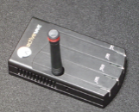

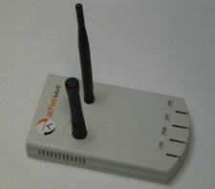

Monitoring Closed Areas
Call Mode
Gate1
Gate2
Gate3
F
F
F
Trigger Mode
F
R
F
Enterprise Systems
Beacon Mode
F
F
F
shipping
Security
Garage

Slide 9
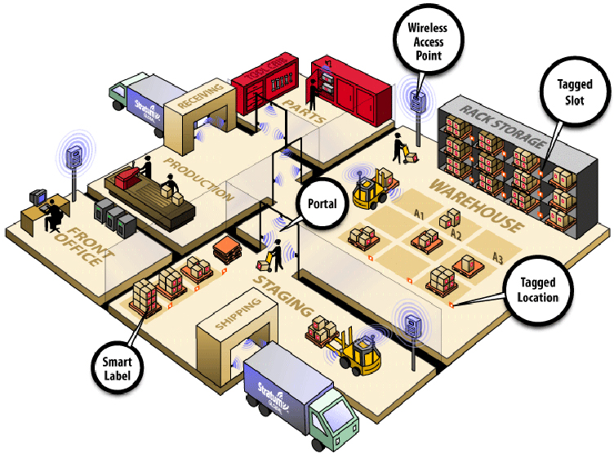
Active RFID Applications
Asset Management
Identify tagged goods by category, value, priority, expiry date, etc.
Tags can respond in given intervals or when instructed to do so.
RFID Active Reader
Active Tags on Merchandise
Active Tags on Merchandise
Active Tags on cases, crates
Portals
Tags can be triggered to respond when moving through a given portal.

Slide 10
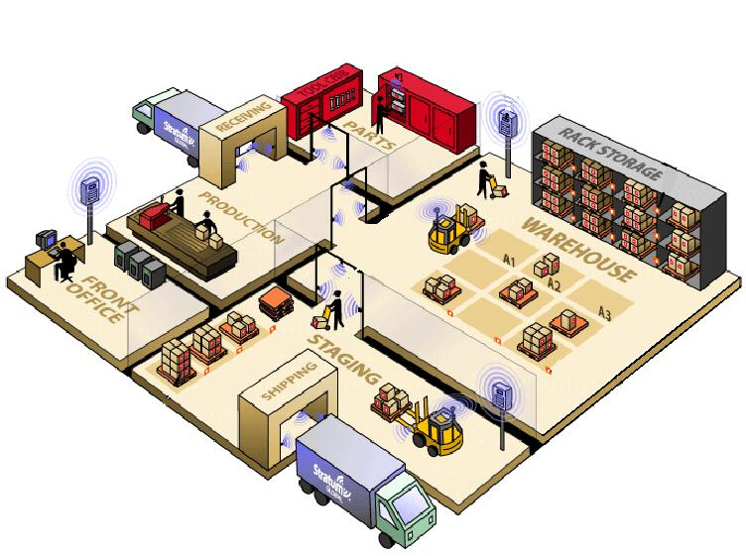
Zoning with Active RFID
Automatic Inventory
Periodically read all tags for real-time inventory control.
Track movement from zone to zone
Movement detected periodically by zoning, or instantly with motion sensor activation.
Active Tags on Merchandise
Active Tags on Merchandise
Active Tags on cases, crates
Locate tags per zone
Find tagged goods instantly throughout the facility or per zone.

Slide 11
Thank You
Your Total RFID Solutions Provider

